Slide 1
What does it mean, to belong
to the descendants of
Franz Jakob Hübert ?

Slide 2
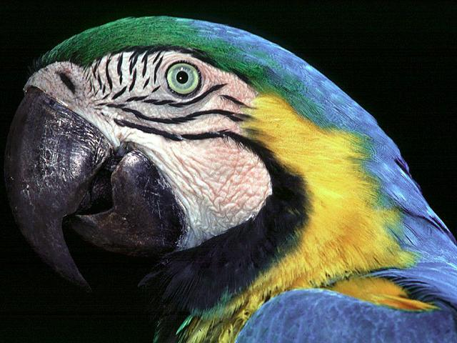

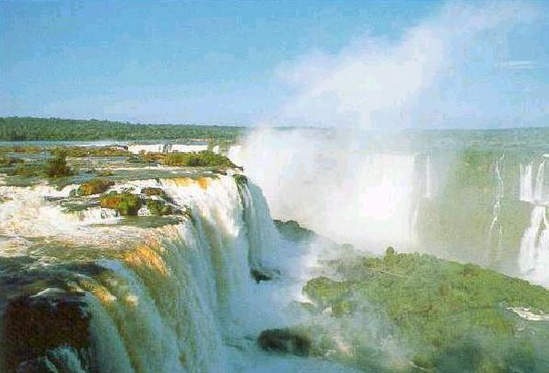
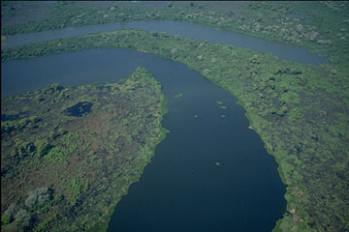


history of our FamiThely
What does it mean, to belong to the descendants of Franz Jakob Hübert ?

Slide 3
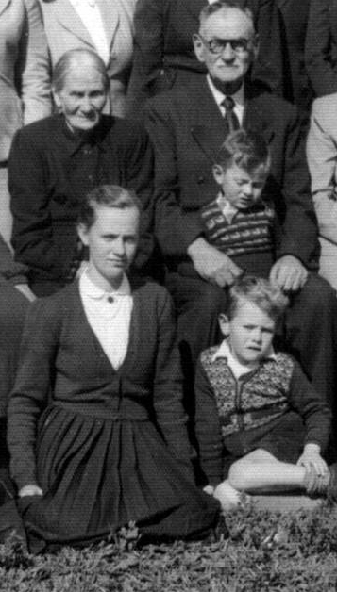
Opas tales
Hüberts
The cosy house in Boqueirão

Slide 4
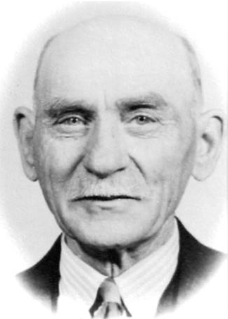
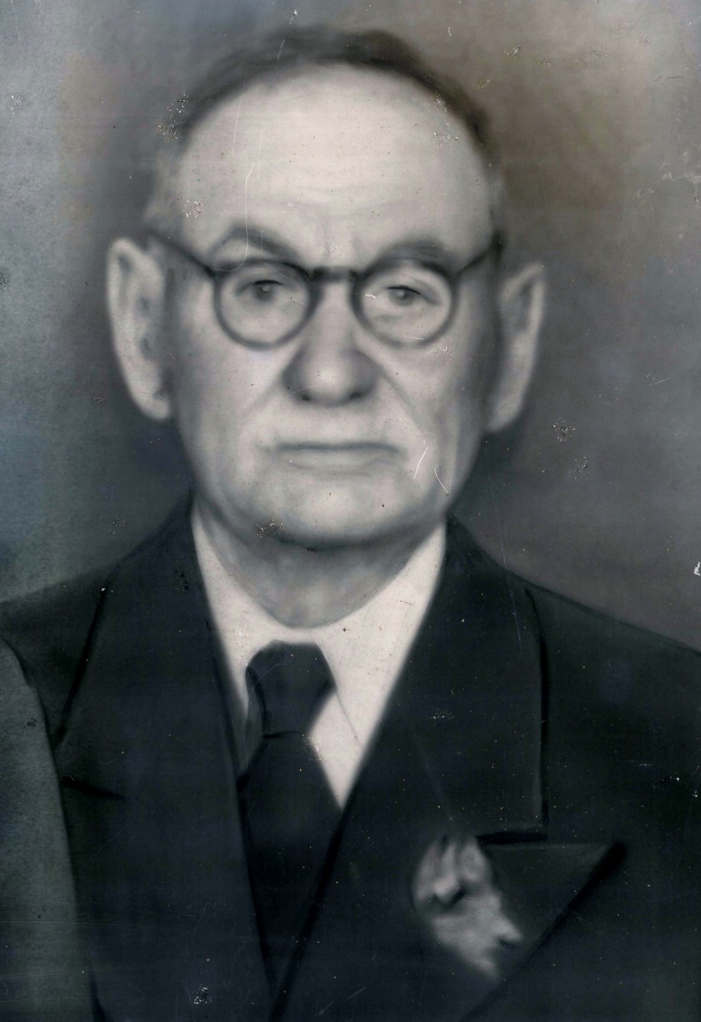
Opas tales
Hüberts
Opa used to tell us often, of his brother in Canada

Slide 5
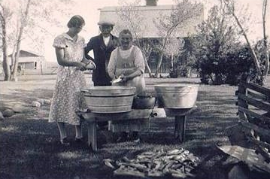
Opas tales
Hüberts
Opa Franz did the same, in Canada

Slide 6
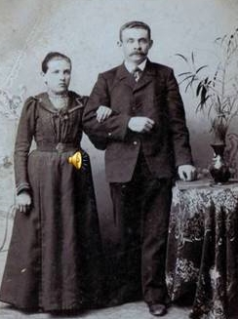
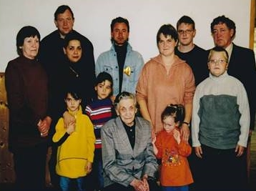
Grandpa´s tales
Hüberts
Opa Heinrich passed away at very young age.
Way too young, for his grandchildren.
Though, aunt „Mieche“ Kliever
told the stories in his place.

Slide 7
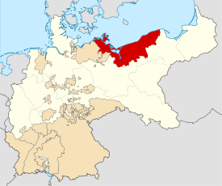
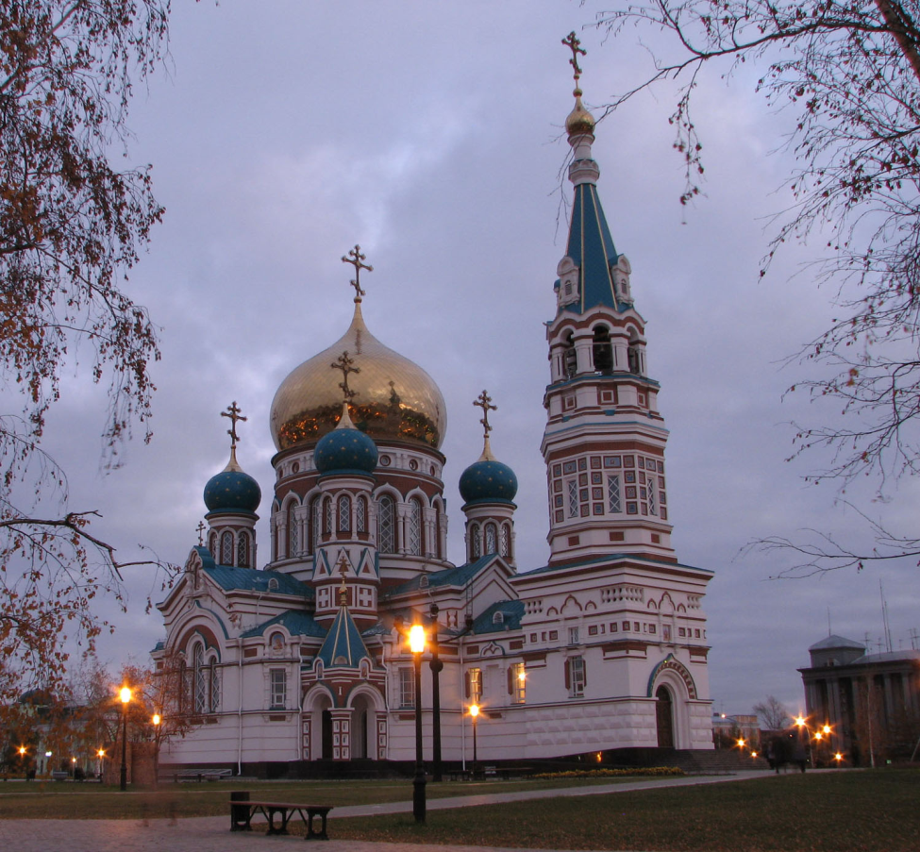
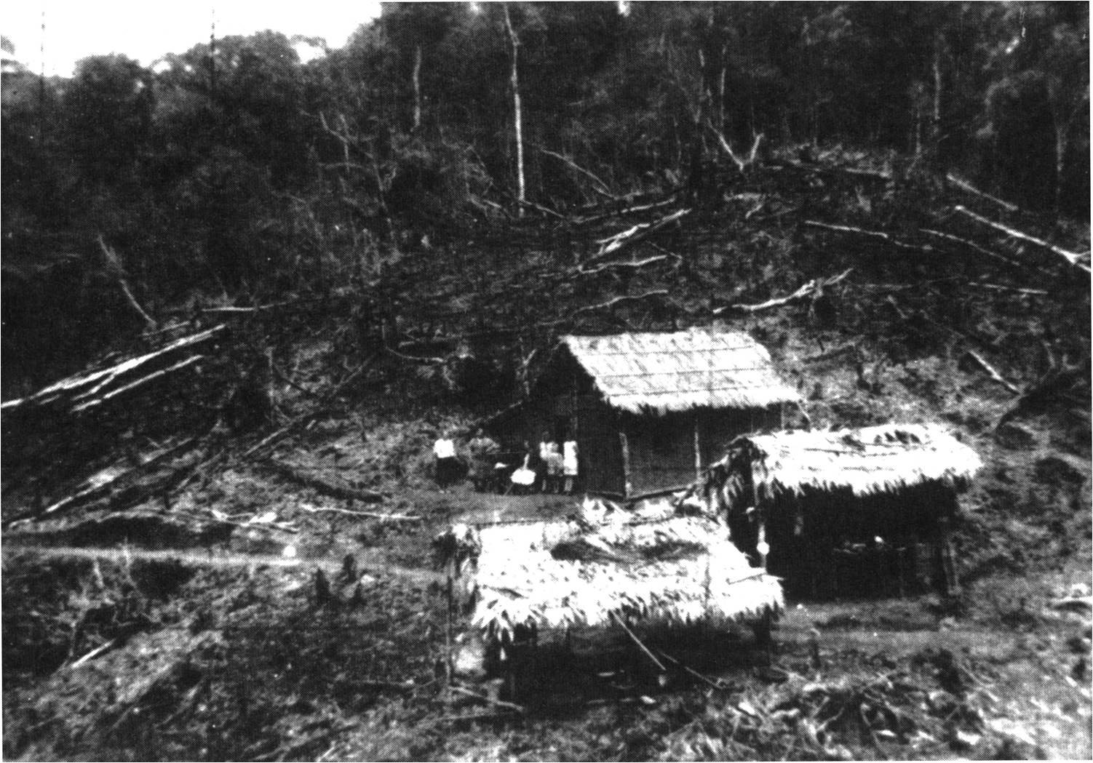
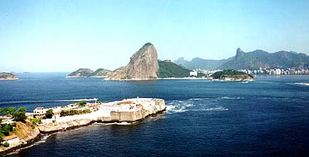
Grandpa´s tales
Hüberts
From Germany,
to Russia…
to Canada…
to Brazil, the first years at the Krauel river….
The huts, with
roofs of
Banana leaves…

Slide 8

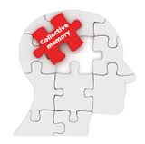
Grandpa´s Tales
Hüberts
All of that makes us think a lot, today…
The stories from Erwin ….
and from our canadian cousins are quite similar….
That shows a collective memory within the family

Slide 9


Grandpa´s tales
Hüberts
What coud that mean to us?
What benefits coud we draw therefrom ?
For us and for our descendants ?

Slide 10

Hüberts
„What you inherited from your parents,
conquer it, in order to posess it“
J. W. v. Goethe 1749 - 1832
!

Slide 11
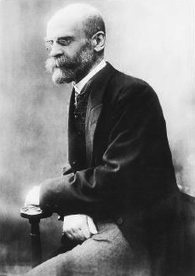
Hüberts
Kollektive conscience
Leads to behaviour, independent of the individual.
Behaviour – Values - Beliefs
Emile Durkheim
1858 - 1917
!

Slide 12
Hüberts
Examples from the animal world
!

Slide 13

Hüberts
They know directions
They have a compass
Have migratory „anxiety“
Individual birds in lab
find their direction too
Reproduction of european
wild geese .
Migratory birds

Slide 14

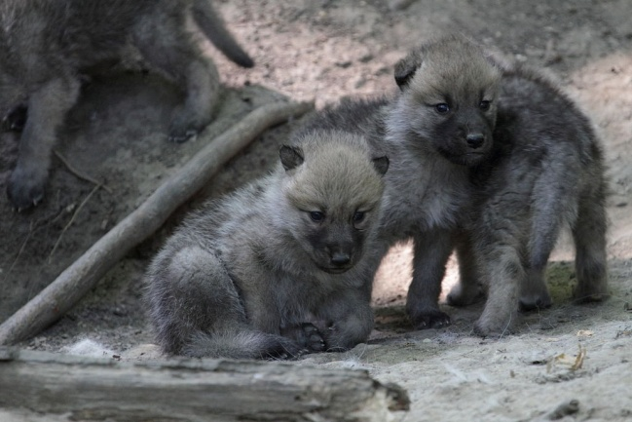
Hüberts
Live in monogamic pairs
Care for cubs of other pairs
Howl diversely :
Warning
Hunting
Calling
Mating
Wolves

Slide 15
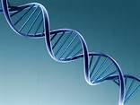
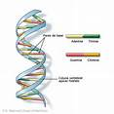
Hüberts
By the same token, we
have much in our
cromosomes
which is embedded in the genome,
that we got from our ancestors.
As with other species, we share much together !

Slide 16
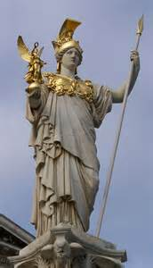

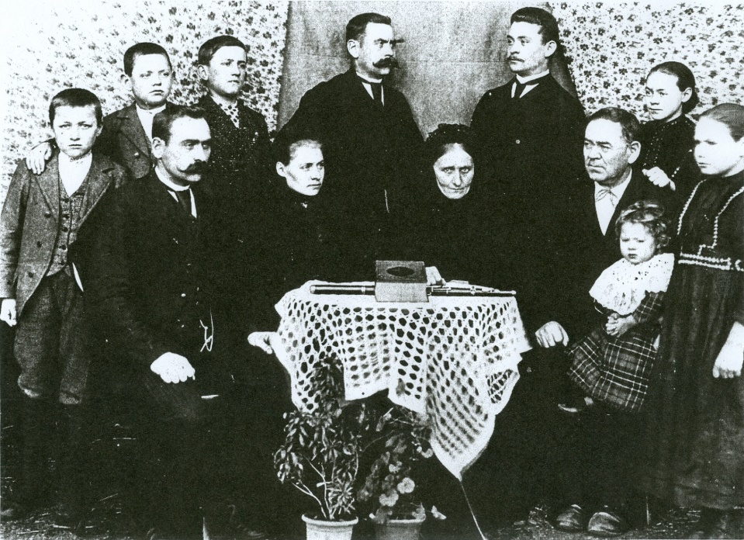
Hüberts
We may learn many things from the history of our
family and its characteristics.

Slide 17
Hüberts
WHAT IN PARTICULAR ??

Slide 18
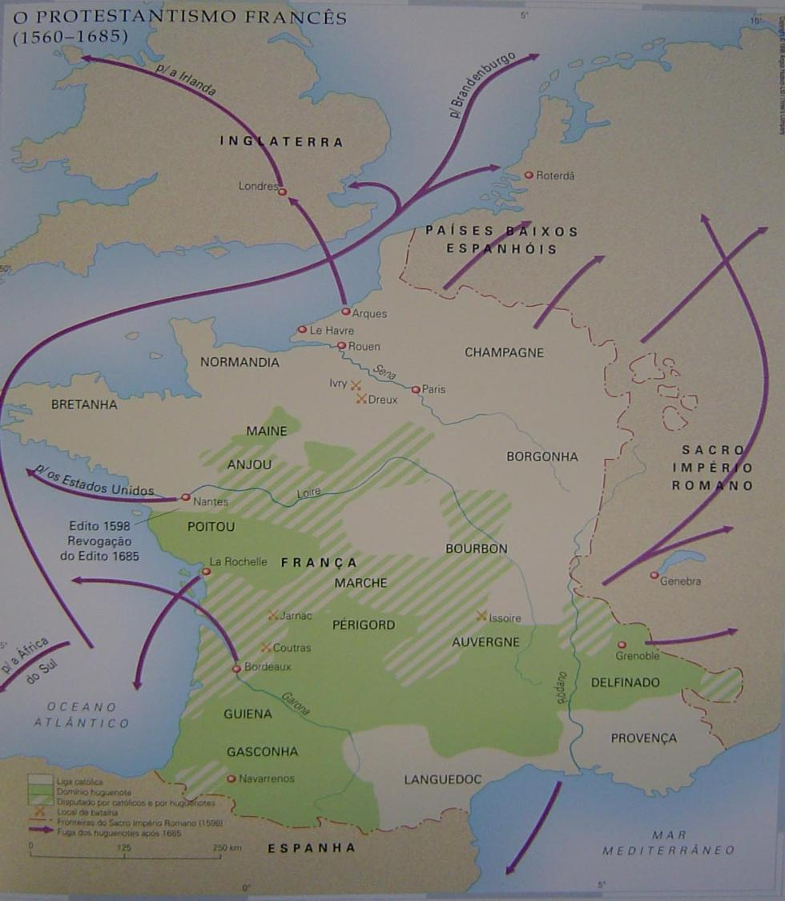
Hüberts
What did our ancestors look for ? :
- Freedom of belief
- Safety
- Opportunity to live and to work
- Possibility to survive
Possibility to unfold their values and their beliefs
Possibility to enlarge their knowledge and to transmit it

Slide 19

Hüberts
After all, what was passed on
from the tree-trunk of Franz Hübert to us and to the next generations ?

Slide 20
Hüberts
Two Things, in particular :
Transmission of behaviour: Tradition
Inherited characteristics : Talents

Slide 21

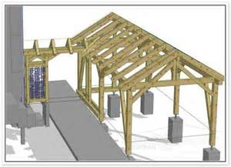
Hüberts
Teachings from the family history
What did we learn through tradition ?
-Endurance
-Perseverance
-Industriousness
-Readiness for change
-Courage
-Determination
-World openess
-Urge for knowledge
-Sense of community
-Solidarity
-Cohesion

Slide 22
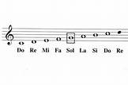
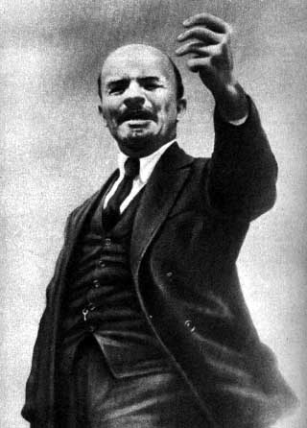
Hüberts
Characteristics of the family genome
What is in our chromosomes ?
-Musical sensitivity
-Eloquence
-Language sensitivity
-Capacity of leadership
-Easy uptake
-Empathy
-Sense of humor
-Rigidity
(Stubbornness)

Slide 23
Hüberts
Teachings from the family history
What does that mean to us and what does it help ?
The more one knows his characteristics and where they came from,
looking onto the history of the family,
The more advantages may be drawn from them.

Slide 24
Hüberts
Teachings from the family history
And, as Goethe said :
The inherited gifts shall be conquered, in order to posess them !
In other words :One shall take advantage of the known gifts and characteristics, inherited or transmitted, with industriousness and strive, in order to use them for one´s self and for the relatives´s best.

Slide 25
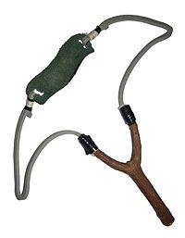
Hüberts
What does family history man after all ?
The history of the family behaves as in a slingshot :
The more one pulls it back,
The further one will project it into the future !

Slide 26
Hüberts
What does it mean for us :
It means, that we have inherited gifts and traditions, which we now know, and which can provide a better future for us and our descendants !

Slide 27
THE E N D !!!

